Slide 1
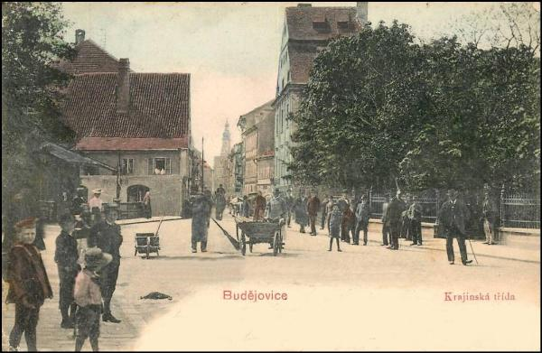
Krajinská Street in the Past
It was the largest and busiest business street in town leading from the square straight to Prague, the capital

Slide 2
View through Krajinská Street 1905

Slide 3
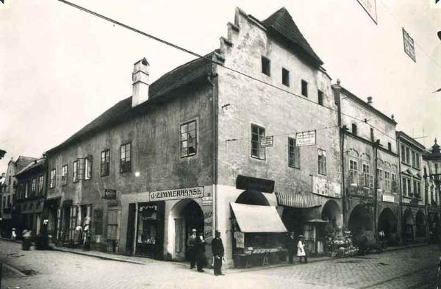
A photo from 1911 showing the place where a bank stands today

Slide 4
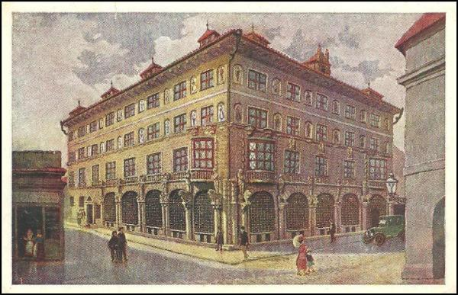
The bank in 1924

Slide 5
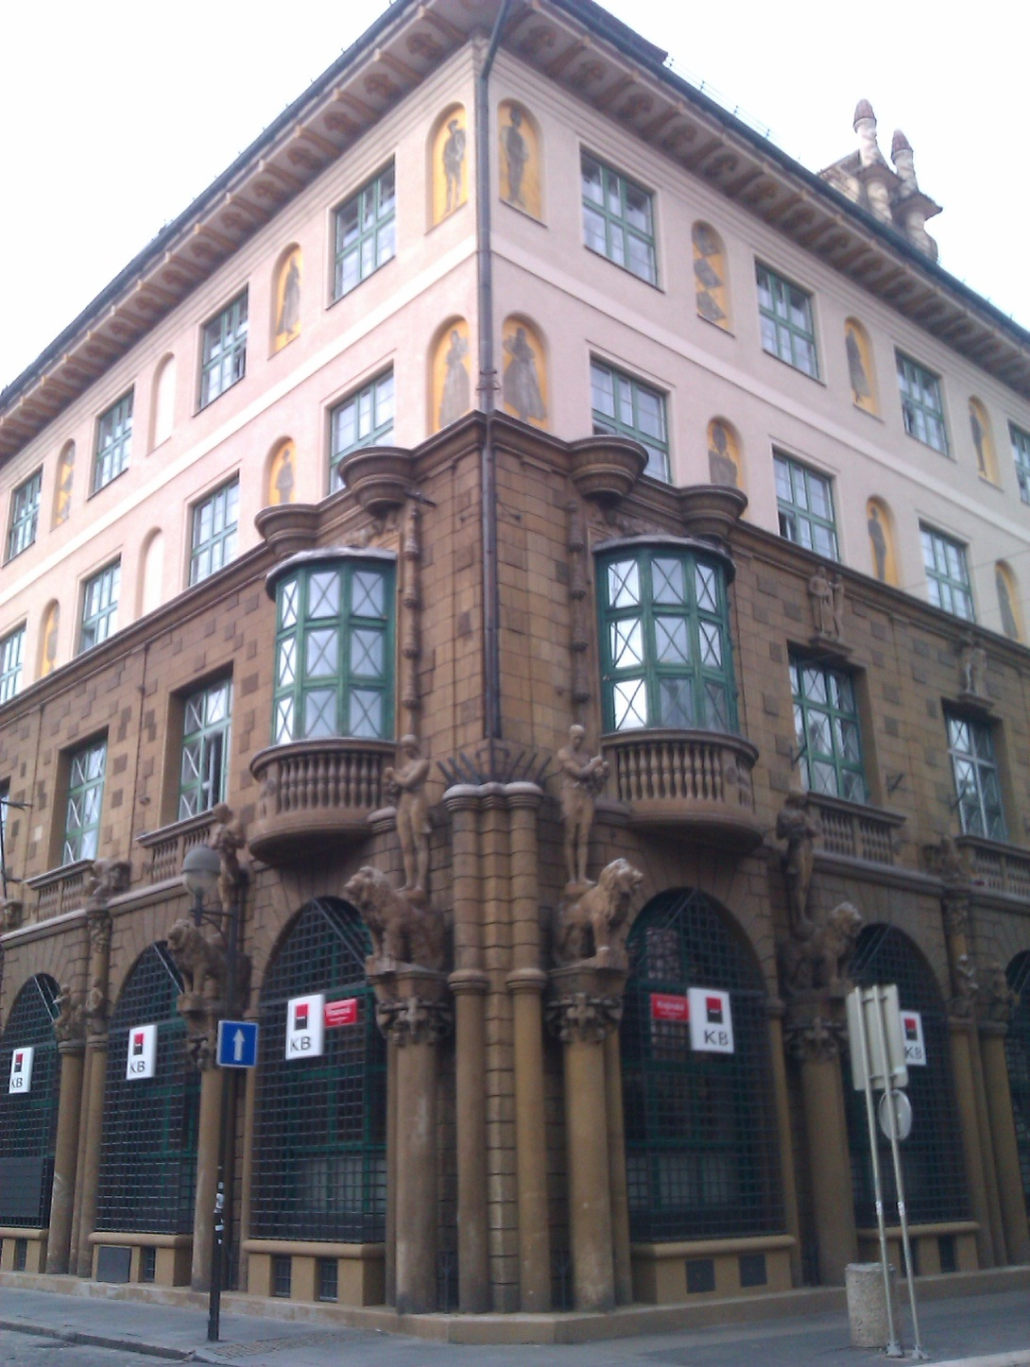
Commercial bank today

Slide 6
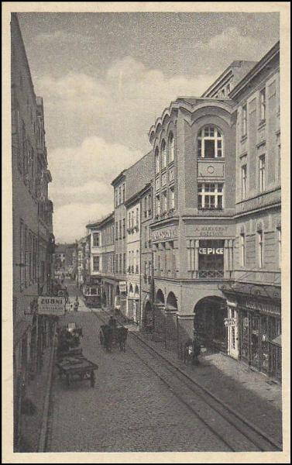
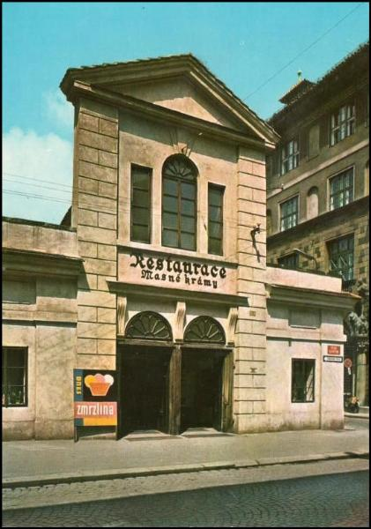
The Rondo department store, 1931,
the Masné krámy restaurant, 1970

Slide 7
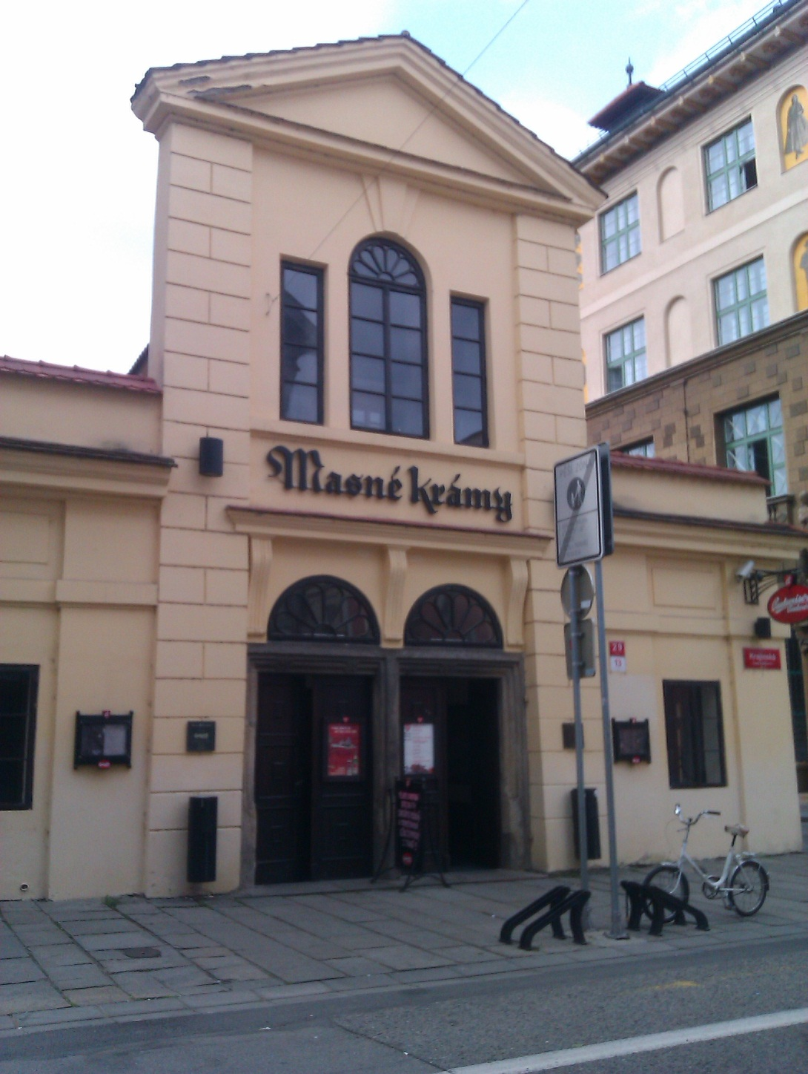
Masné krámy
today

Slide 8
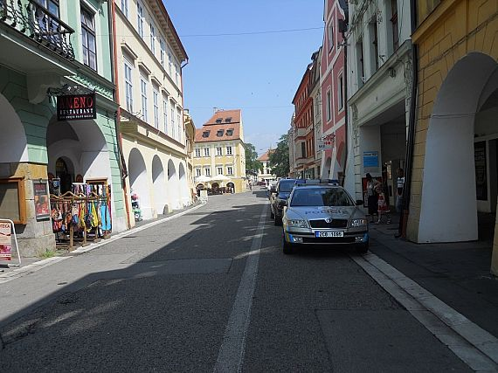
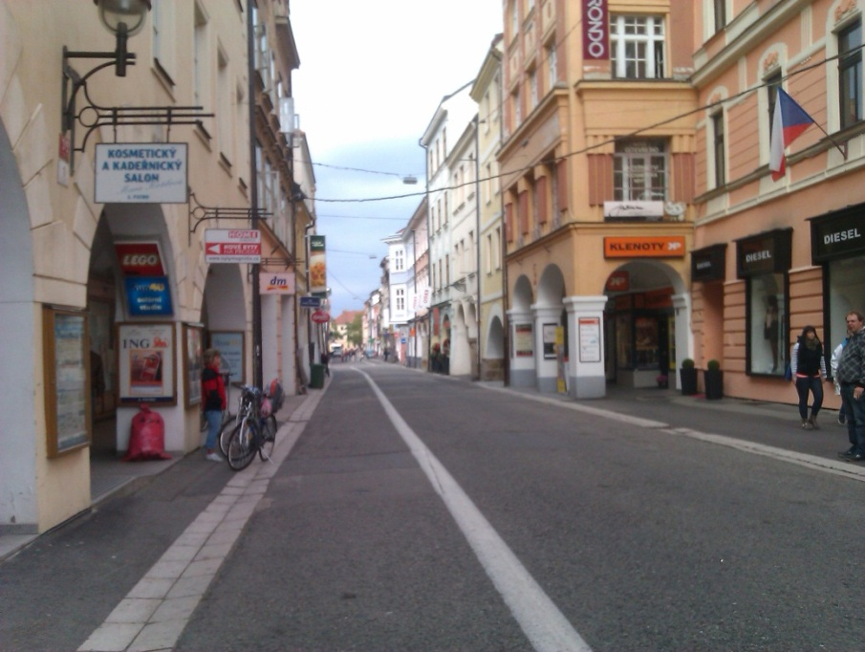
Krajinská Street today
Today there still are many shops and restaurants, but it is not important as a trade route to Prague like before

Slide 9
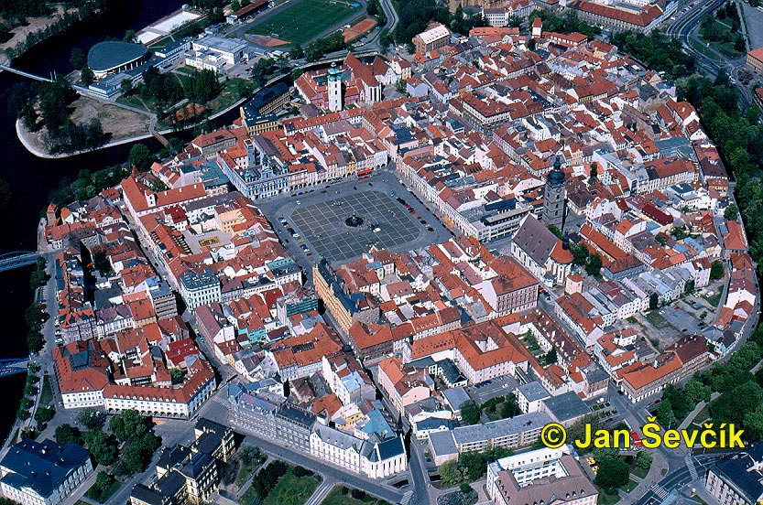
Krajinská Street

Slide 10
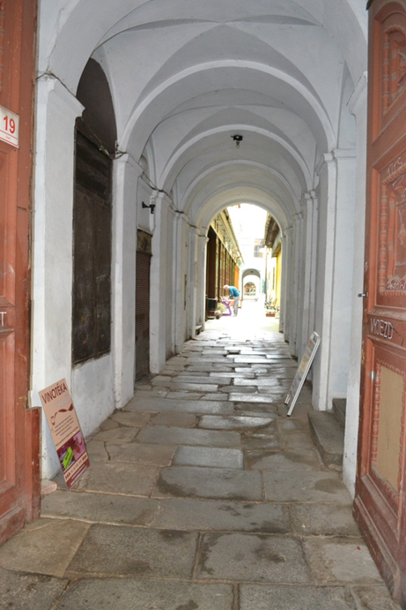
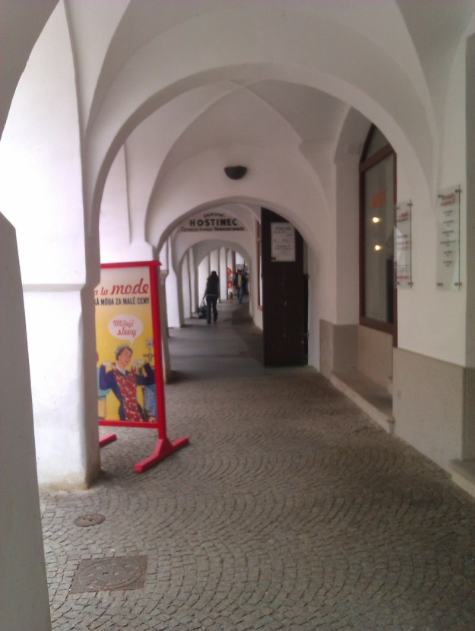
Krajinská street is lined with beautiful vaulted arcades, a typical feature of the historical centre.
In the past,they were used as arcade shops

Slide 11
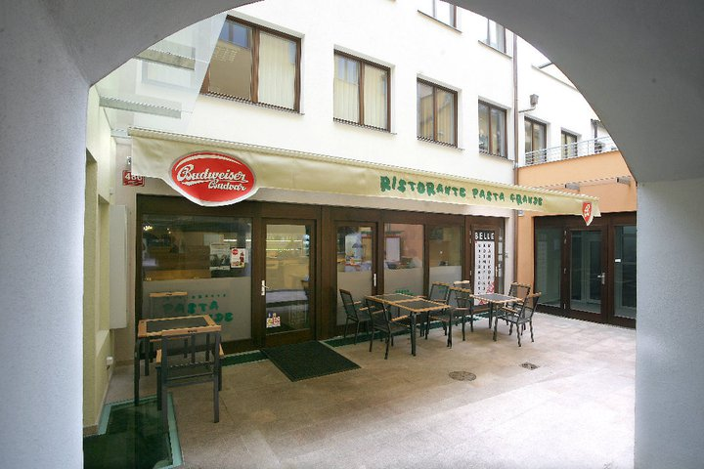
Ristorante Pasta Grande

Slide 12
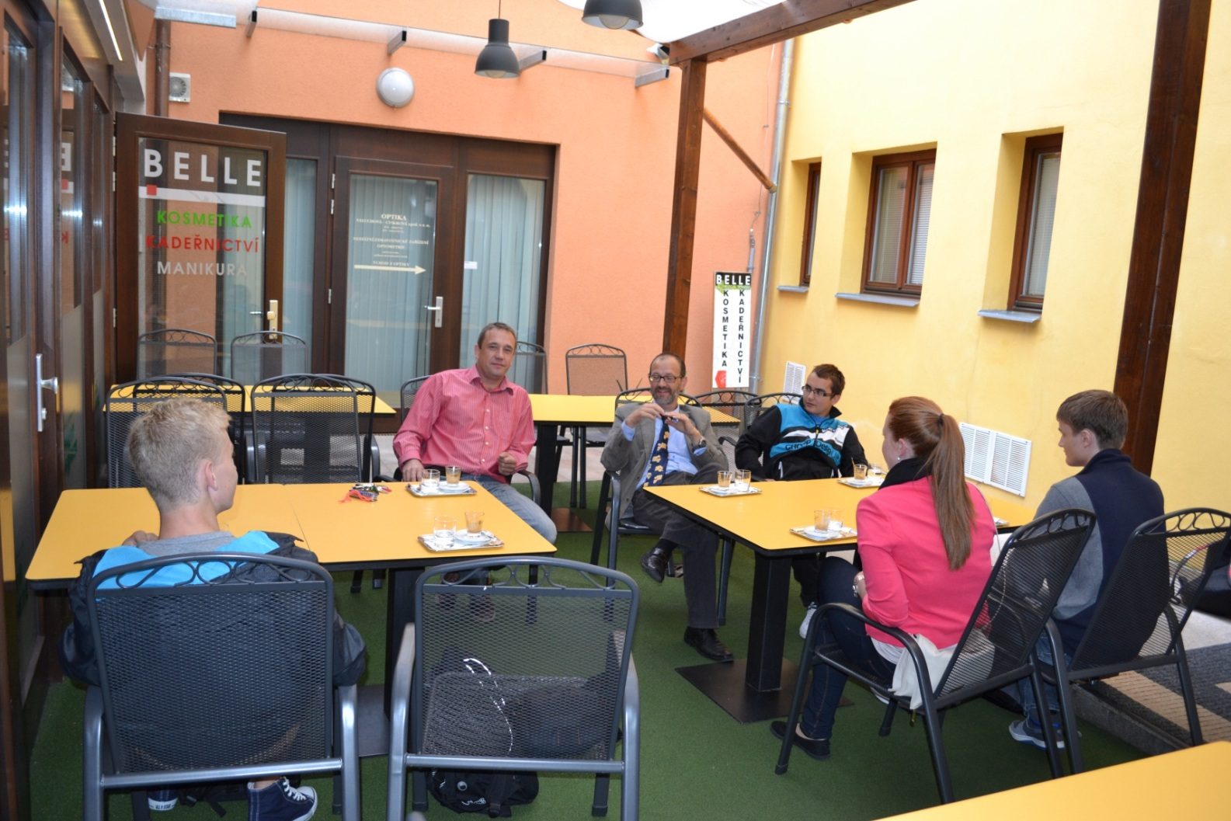
This is us at the meeting in the Pasta Grande with Mr. Martin Pražák

Slide 13
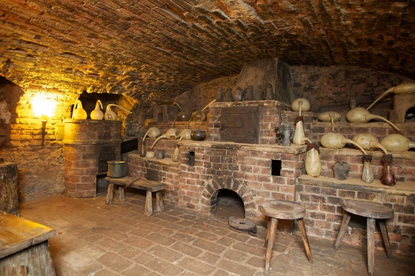
In the past, local people made soap in this house.
The town archaeologist told us that it was the oldest documented soap making workshop in the country

Slide 14
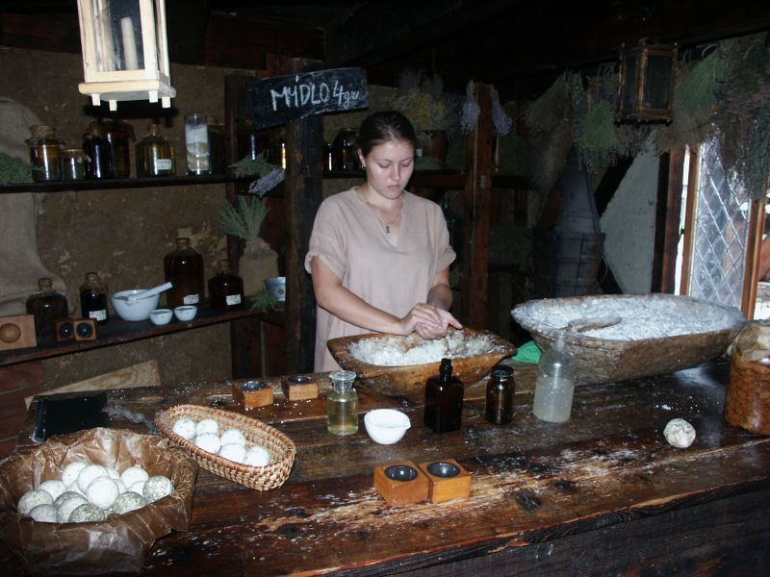
Soap is a salt of a fatty acid
There are two ways how to make soap: Cold process and Hot process
Either way it was pretty smelly and disgusting

Slide 15
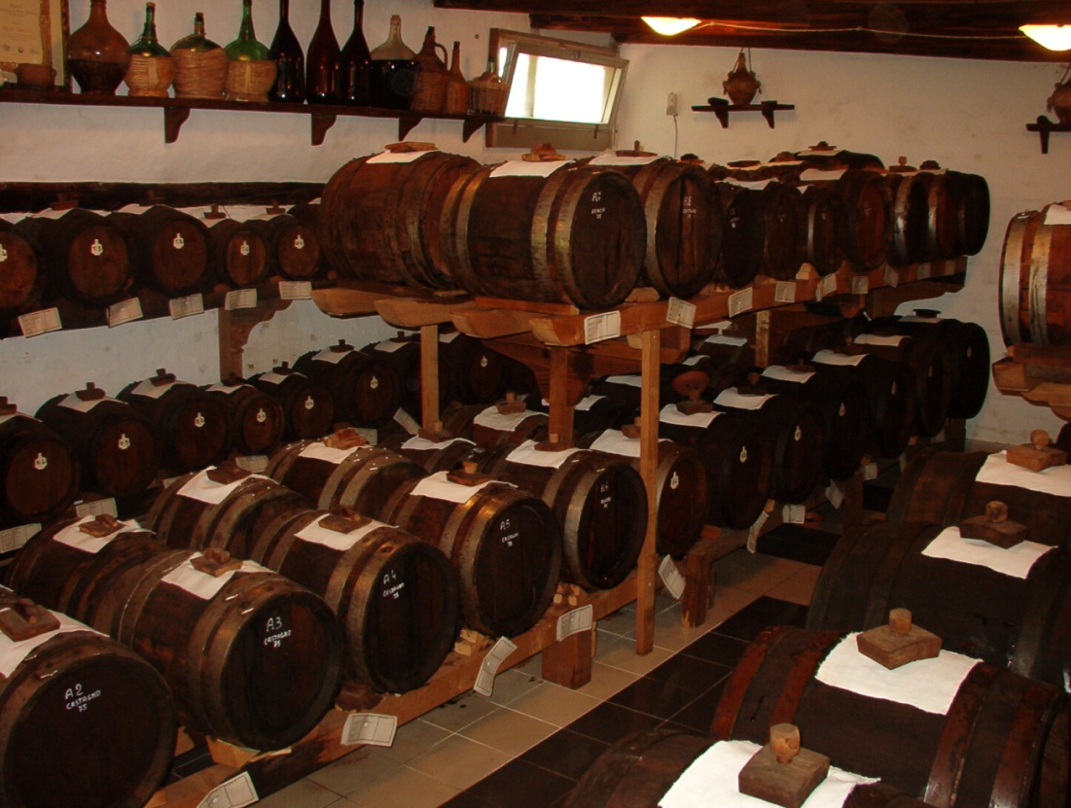
Later, this building became a vinegar factory and warehouse
The production ended only a few years ago, then the house was empty.

Slide 16
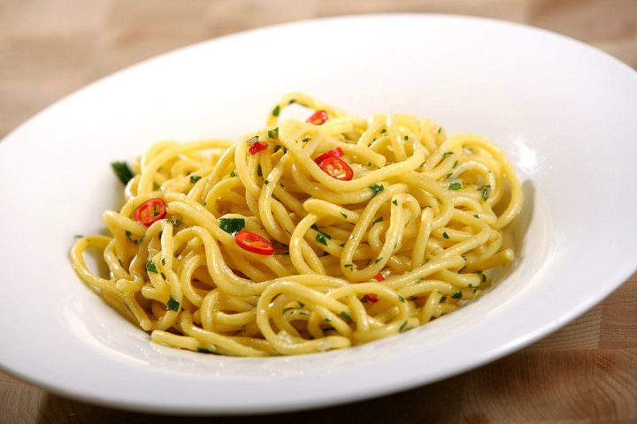
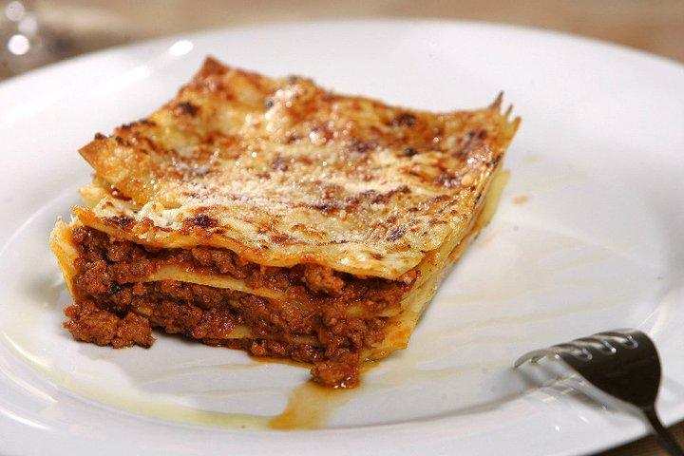
Today there is a great Italian restaurant with many kinds of meals
Spaghetti
Lasagna

Slide 17
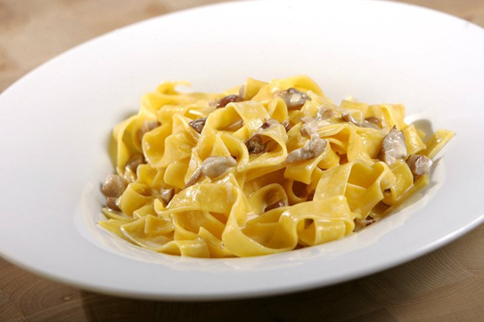
My favourite Penné
Fresh pasta with chicken

Slide 18
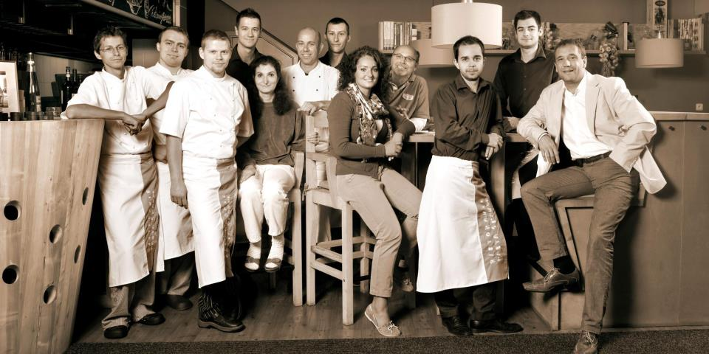
The Boss, Mr. Martin Pražák and his team

Slide 19
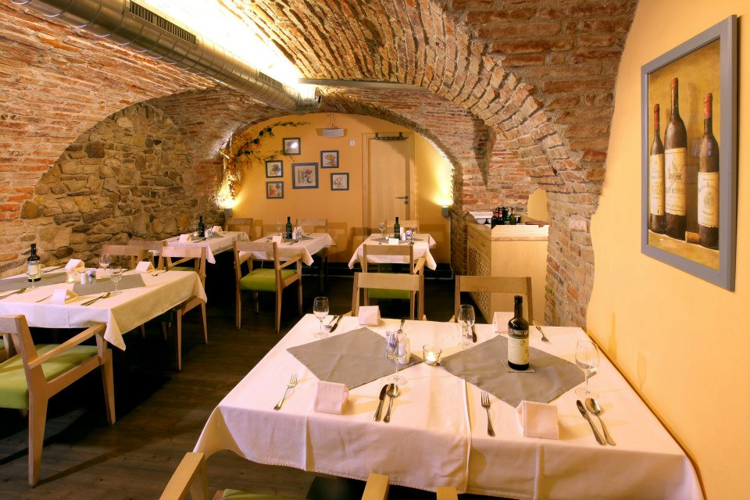
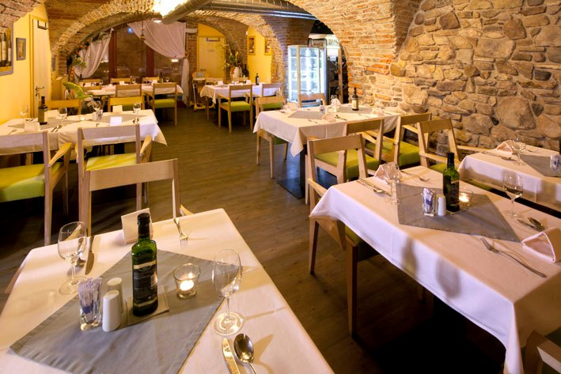
Inside, there is a pleasant environment in the Italian style
It‘s a good place for business meetings and romantic dates under a cupola vault

Slide 20
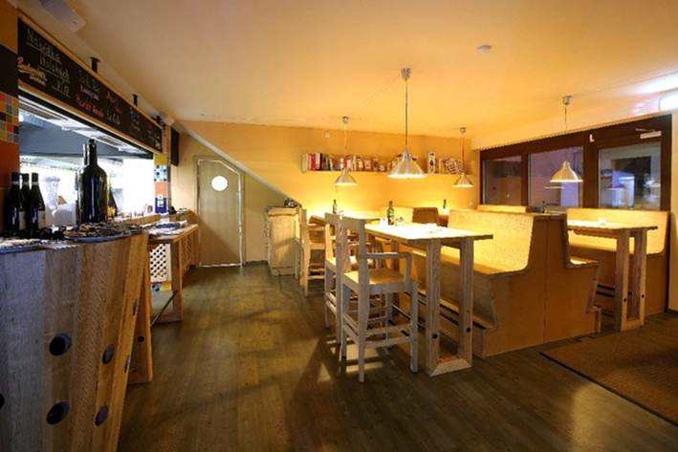
There is a wine bar, too

Slide 21
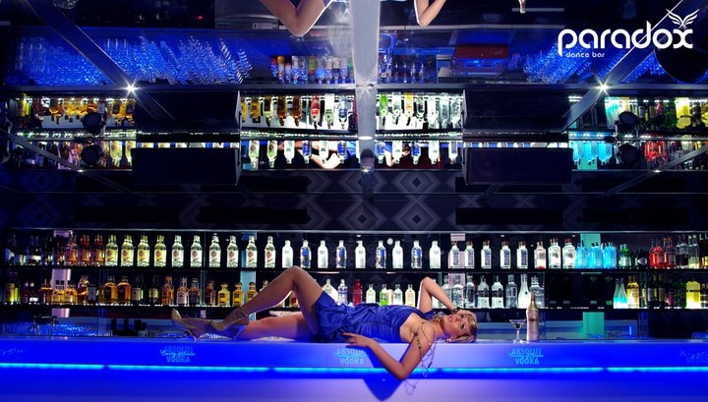
Under the restaurant there is a disco, called the Paradox . It's a great place for a party. But you must be 18 to get in.

Slide 22
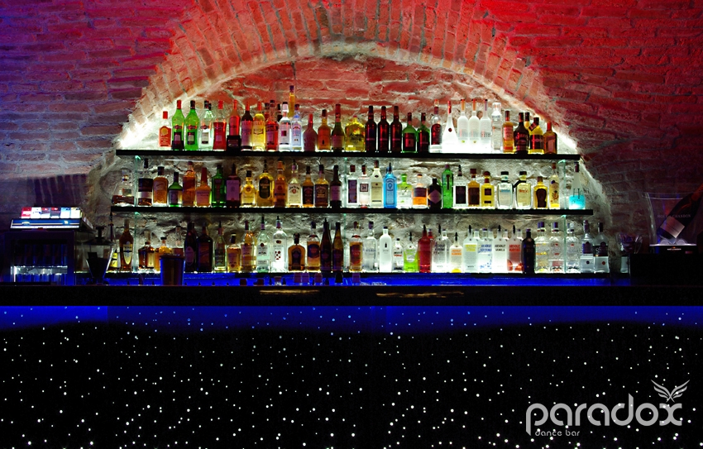
The designer loves colours …

Slide 23
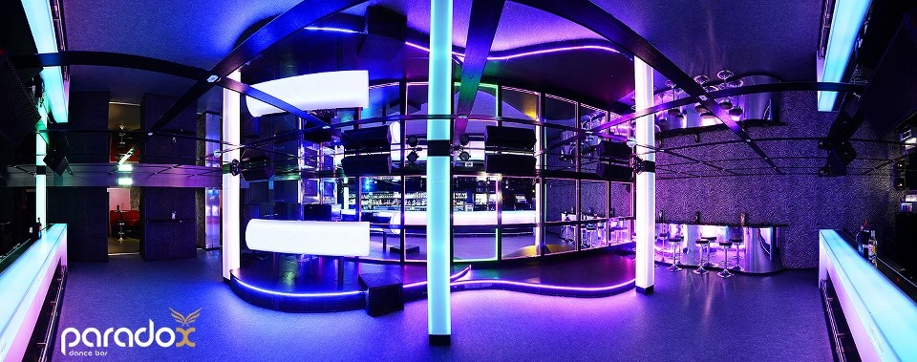
Can you believe this modern interior is inside a historical house???

Slide 24
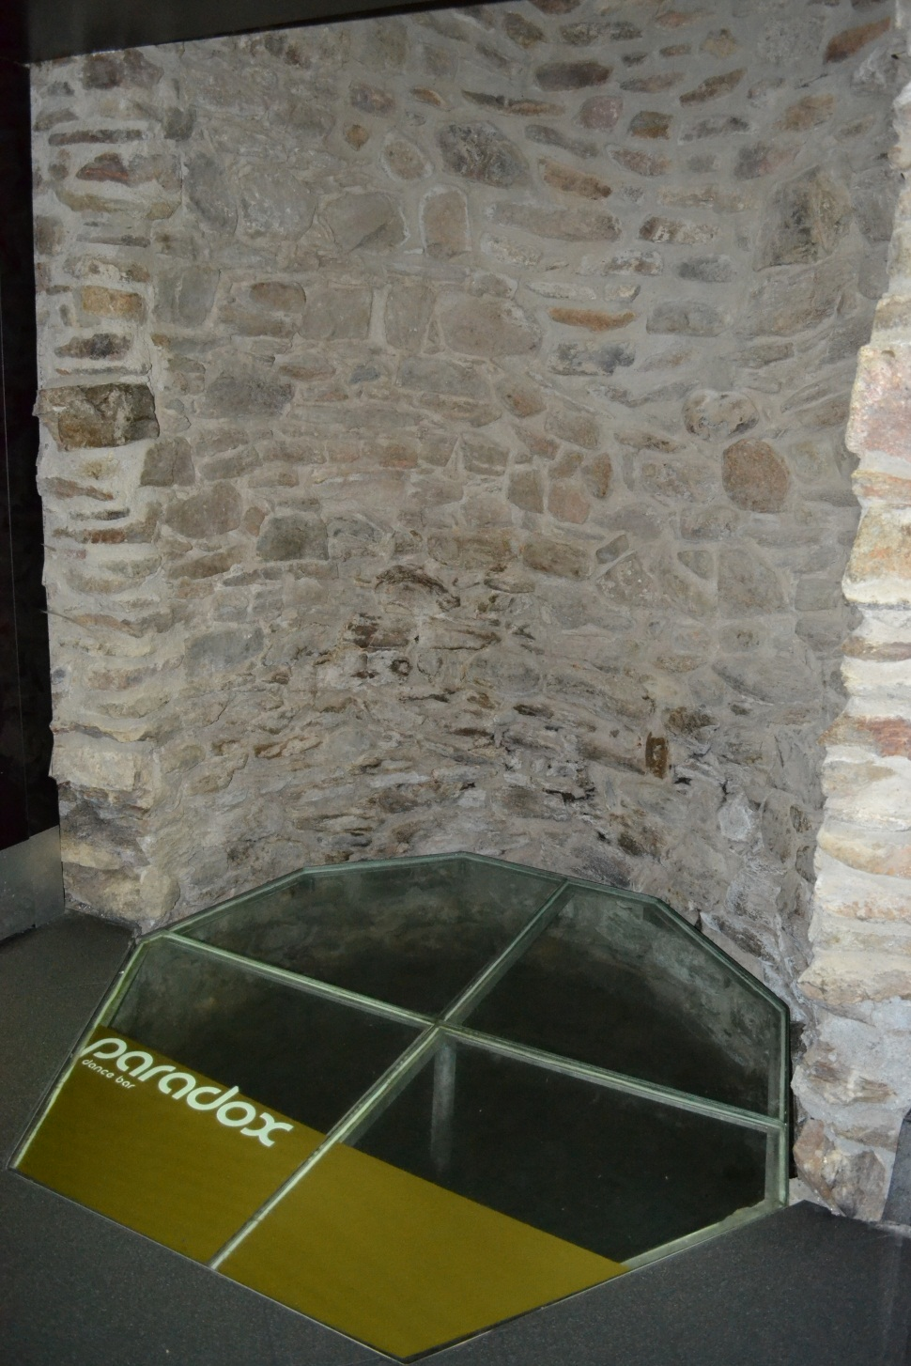
During the latest recostruction an old well was dicsovered

Slide 25
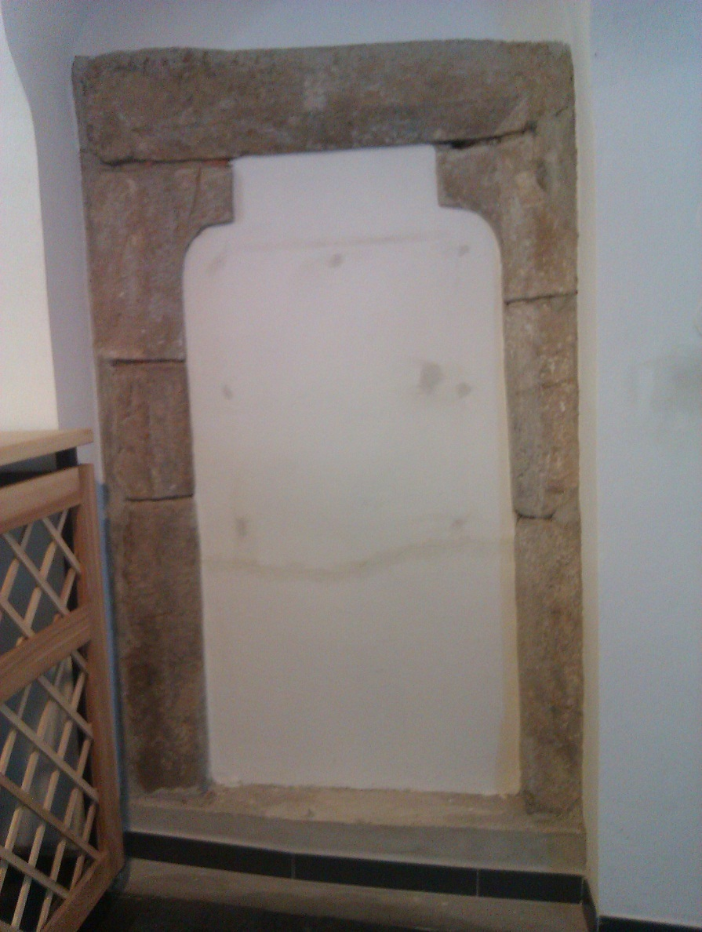
This is one of the oldest parts of the house, a stone window case

Slide 26
Here, Martin Pražák is showing us how high water reached during the flood in 2002

Slide 27
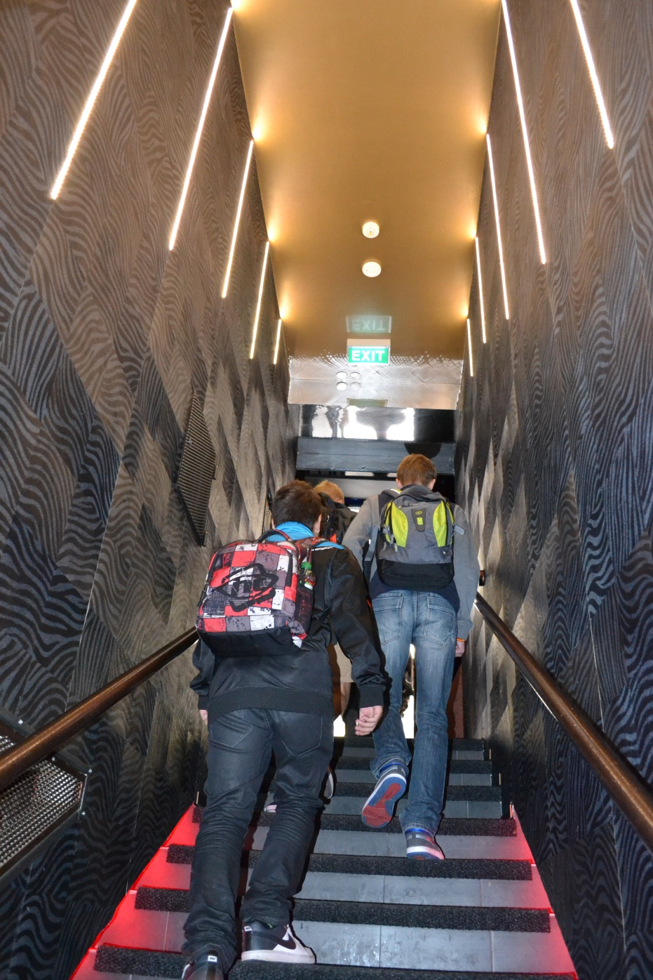
There are us leaving the club and my presentation ends.
☺

Slide 28
See you
in České Budějovice
in March / April 2014

